Slide 1
School of Computer Science & Engineering
AI Application Development – IA1
AI Contract And Financial Intelligence Platform

Slide 2
Team members & roles
Team member name | Role
Khushi M | Team Head
Surya Priya G | Customer Contact Lead
L Sujay Gowda | Development Lead
Pavani V | Test Lead
Olivia Sam | Developer
Notes:
Talk about how they are managing their documents, how google docs does automatic versioning
As them what they know about Android and IoS versions

Slide 3
Problem Statement
Many users sign contracts without understanding complex legal terms, leading to hidden risks and financial loss.There is no simple way to identify penalties, unfair clauses, or actual financial impact before signing.
Notes:
Talk about how they are managing their documents, how google docs does automatic versioning
As them what they know about Android and IoS versions

Slide 4
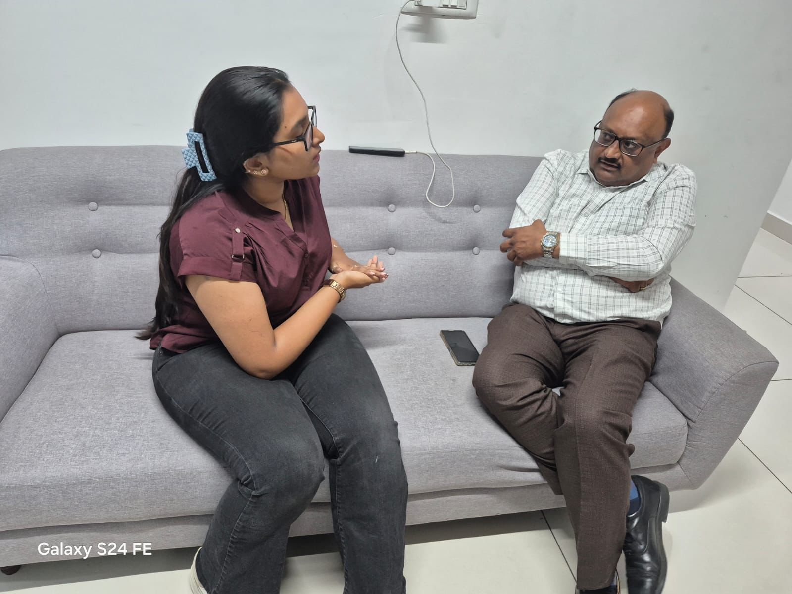
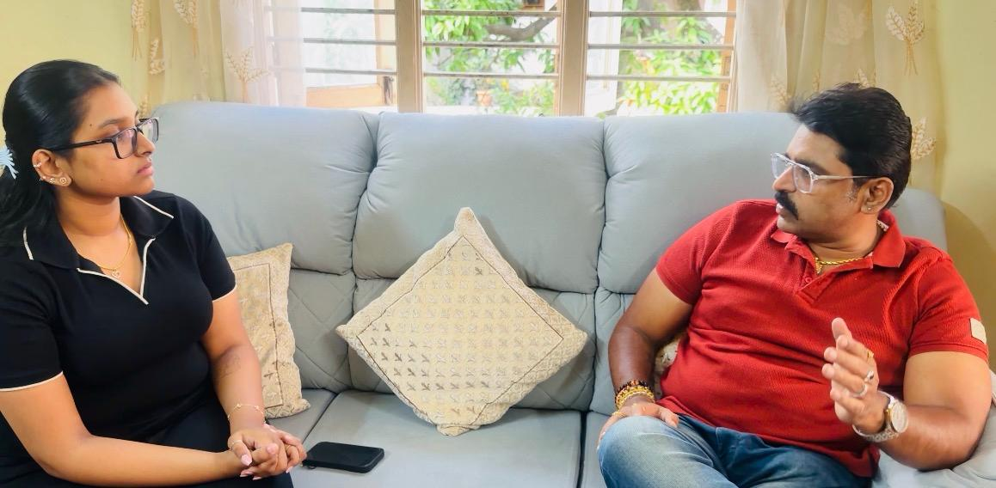
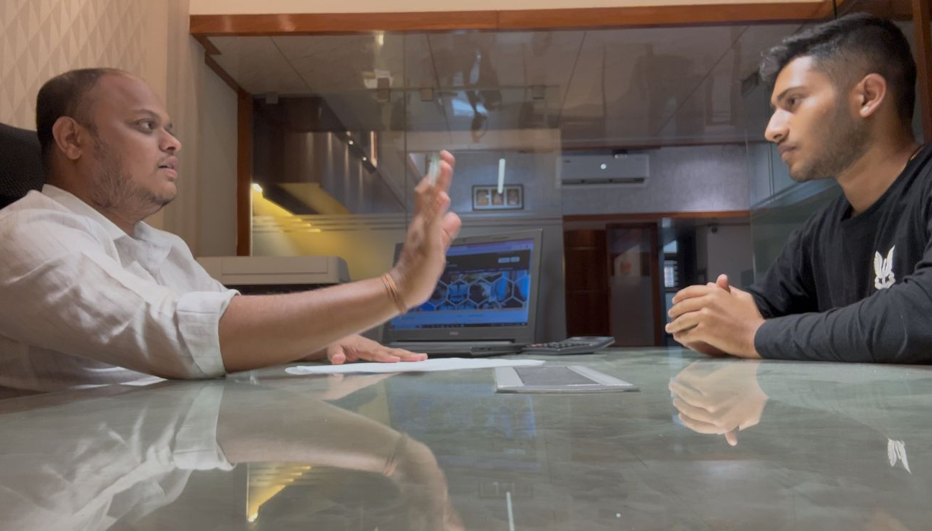
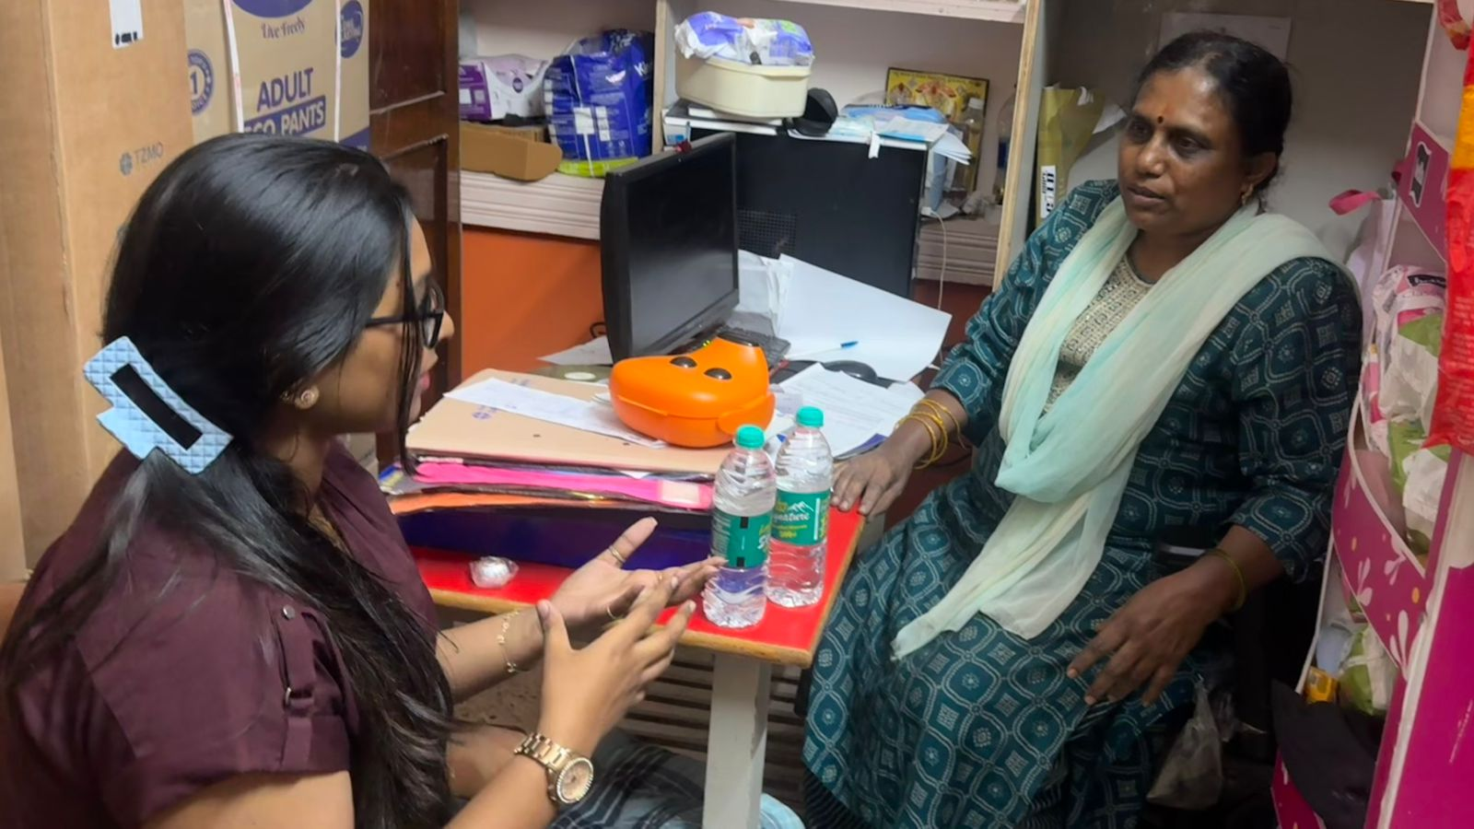
User/ Customer Understanding
Naptico Green Energy Solars Private Limited
Khushi Medico
CA Auditor and Tech-Savvy Professional
Amrutha Associates
https://youtu.be/Oa-6wuGLrJo?si=vQWxO0uiwCAZdYUj
Notes:
Talk about how they are managing their documents, how google docs does automatic versioning
As them what they know about Android and IoS versions

Slide 5
Ideal Customer Profile (ICP)
1. Demographic Profile
Working professionals (age 25–50)
Roles: Administrators, Managers, Data Analysts
Organizations: Colleges, NGOs, Small & Medium Businesses
Technical Skills: Basic computer knowledge
2. Psychographic Profile
Wants to save time in analyzing documents and reports
Finds manual analysis repetitive and time-consuming
Prefers simple and automated tools for ease of use
Needs quick insights for faster decision-making
Values clarity and accuracy, especially before making decisions
Notes:
Only stress on the 1st sentence – the definition
Come back to the 2nd sentence in the end as part of revision

Slide 6

Customer Persona (CP)
Demographic Profile
IT professional working as a freelancer
Manages 5–10 clients monthly
Basic to moderate technical knowledge
Psychographic Profile
Frequently deals with contracts and technical documents
Wants quick and simple understanding of complex content
Finds manual reading and analysis time-consuming
Prefers automated tools that simplify information
Needs clear insights before making decisions
Name: Rahul Sharma Age: 32 Role: Freelance Software Developer Location: Bengaluru Work Type: Independent Freelancer (IT Services)
Notes:
Only stress on the 1st sentence – the definition
Come back to the 2nd sentence in the end as part of revision

Slide 7
Product USP
• Simplifies complex contracts into easy language, saving time and confusion • Detects hidden risks, penalties, and unfair clauses before signing • Calculates real financial impact, helping users avoid unexpected losses • Provides AI chatbot for instant contract-related queries • Unique combination of contract analysis + risk detection + financial simulation in one platform • Unlike other tools, it focuses on both legal understanding and financial intelligence
Notes:
Only stress on the 1st sentence – the definition
Come back to the 2nd sentence in the end as part of revision

Slide 8
Use Cases & High level Requirements
1. Contract Risk Analysis Input: Upload agreement Output: Highlighted risks + clear summary
2. Clause Simplification Input: Complex legal text Output: Simple, easy-to-understand explanation
3. Missing Clause Detection Input: Draft agreement Output: Alerts for missing critical clauses (e.g., termination, penalties)
4. Payment & Liability Breakdown Input: Financial clauses in contract Output: Clear breakdown of payment structure and user obligations
Notes:
Only stress on the 1st sentence – the definition
Come back to the 2nd sentence in the end as part of revision

Slide 9
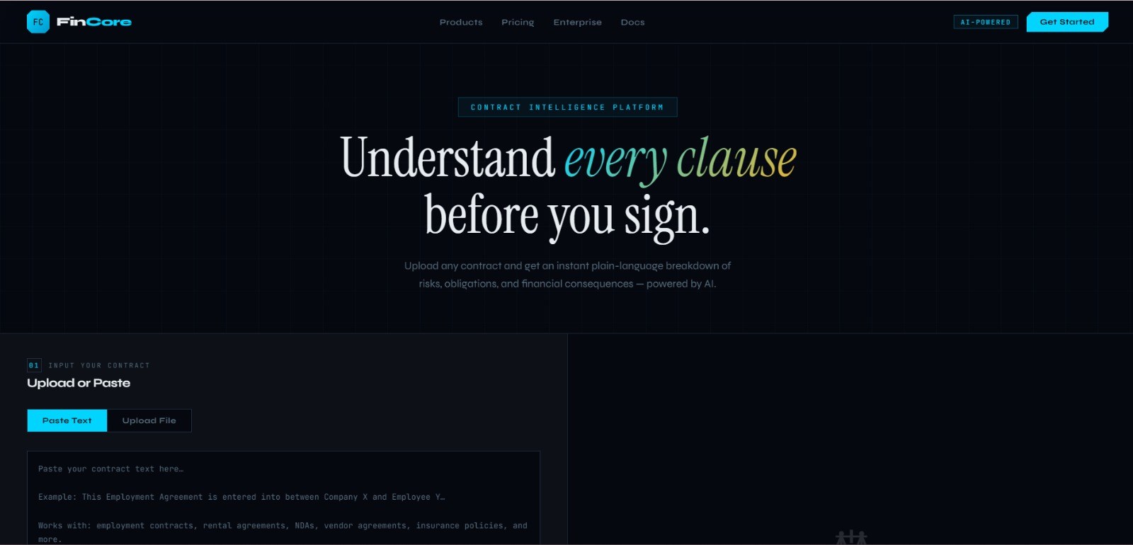
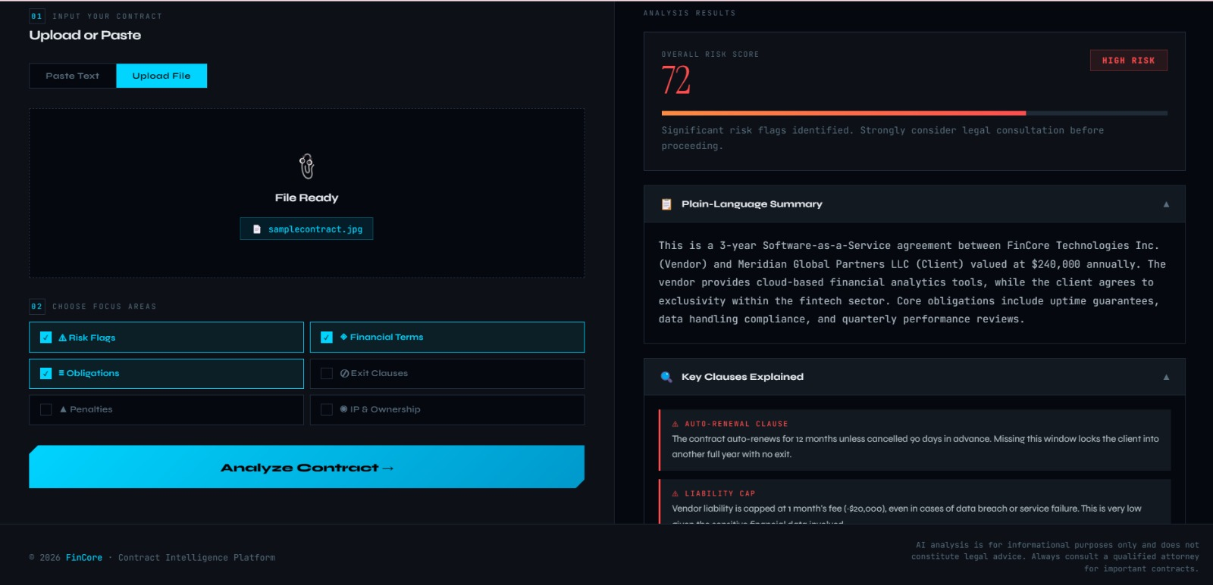
Prototype Demo
Notes:
Only stress on the 1st sentence – the definition
Come back to the 2nd sentence in the end as part of revision

